Slide 1
Other Software Processes
Other Processes

Slide 2
Other Processes
Development Process is the central process around which others revolve
Methods for other processes often influenced by the dev process
We have looked at various models for dev process; a real process may be derived from a model
Other Processes

Slide 3
Other Processes
Project management process
Inspection process
Configuration management process
Change management process
Process Management Process
Will briefly look at these now
Other Processes

Slide 4
Project Management Process
Other Processes

Slide 5
Background
Development process divides development into phases and activities
To execute it efficiently, must allocate resources, manage them, monitor progress, take corrective actions, …
These are all part of the PM process
Hence, PM process is an essential part of executing a project
Other Processes

Slide 6
PM Process Phases
There are three broad phases
  Planning
  Monitoring and control
  Termination analysis
Planning is a key activity that produces a plan, which forms the basis of monitoring
Other Processes

Slide 7
Planning
Done before project begins
Key tasks
  Cost and schedule estimation
  Staffing
  Monitoring and risk mgmt plans
  Quality assurance plans
  Etc.
Will discuss planning in detail later
Other Processes

Slide 8
Monitoring and control
Lasts for the duration of the project and covers the development process
  Monitors all key parameters like cost, schedule, risks
  Takes corrective actions when needed
  Needs information on the dev process – provided by metrics
Other Processes

Slide 9
Termination Analysis
Termination analysis is performed when the development process is over
Basic purpose: to analyze the perf of the process, and identify lessons learned
Also called postmortem analysis
Other Processes

Slide 10
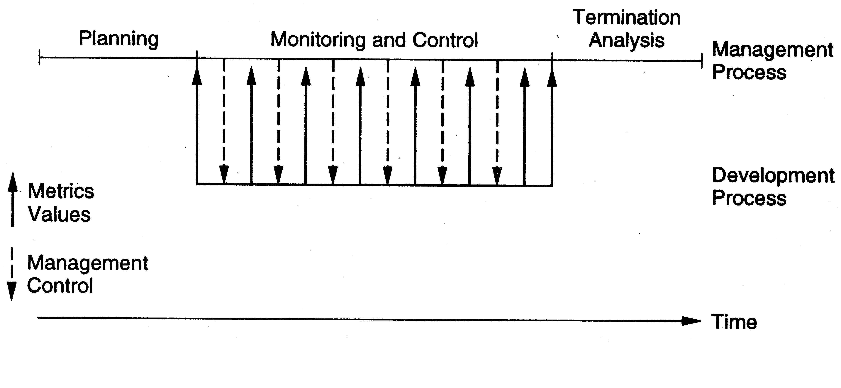
Relationship with Dev Process
Other Processes

Slide 11
The Inspection Process
Other Processes

Slide 12
Background
Main goal of inspection process is to detect defects in work products
First proposed by Fagan in 70s
Earlier used for code, now used for all types of work products
Is recognized as an industry best practice
Data suggests that it improves both Q&P
Other Processes

Slide 13
Background
Defects injected in sw at any stage
Hence must remove them at every stage
Inspections can be done on any document including design docs and plans
Is a good method for early phases like requirements and design
Also useful for plans (PM plans, CM plans, testing plans,…)
Other Processes

Slide 14
Some Characteristics
Conducted by group of technical people for technical people (i.e. review done by peers)
Is a structured process with defined roles for the participants
The focus is on identifying problems, not resolving them
Review data is recorded and used for monitoring the effectiveness
Other Processes

Slide 15
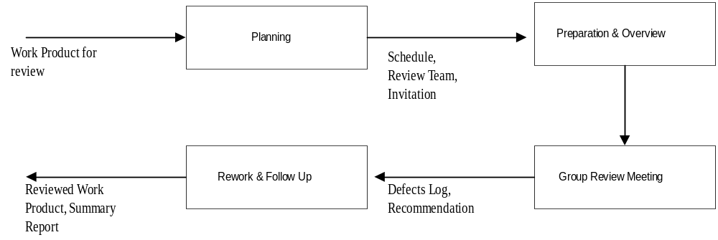
A Review Process
Other Processes

Slide 16
Planning
Select the group review team – three to five people group is best
Identify the moderator – has the main responsibility for the inspection
Prepare package for distribution – work product for review plus supporting docs
Package should be complete for review
Other Processes

Slide 17
Overview and Self-Review
A brief meeting – deliver package, explain purpose of the review, intro,…
All team members then individually review the work product
  Lists the issues/problems they find in the self-preparation log
  Checklists, guidelines are used
Ideally, should be done in one sitting and issues recorded in a log
Other Processes

Slide 18
Self-Review Log
Project name:
Work product name and ID:
Reviewer Name
Effort spent (hours)
Defect list
  No Location Description Criticality
Other Processes

Slide 19
Group Review Meeting
Purpose – define the final defect list
Entry criteria – each member has done a proper self-review (logs are reviewed)
Group review meeting
  A reviewer goes over the product line by line
  At any line, all issues are raised
  Discussion follows to identify if a defect
  Decision recorded (by the scribe)
Other Processes

Slide 20
Group Review Meeting…
At the end of the meeting
  Scribe presents the list of defects/issues
  If few defects, the work product is accepted; else it might be asked for another review
  Group does not propose solutions – though some suggestions may be recorded
  A summary of the inspections is prepared – useful for evaluating effectiveness
Other Processes

Slide 21
Group Review Meeting…
Moderator is in-charge of the meeting and plays a central role
  Ensures that focus is on defect detection and solutions are not discussed/proposed
  Work product is reviewed, not the author of the work product
  Amicable/orderly execution of the meeting
  Uses summary report to analyze the overall effectiveness of the review
Other Processes

Slide 22
Summary Report Example
Project Work Product Type Size of work product Review team Effort (person hours) Preparation Group meeting Total | XXXX Project plan 14 pages P1, P2, P3 10 (total) 10 20
Other Processes

Slide 23
Summary Contd.
Defects No of critical defects No of major defects No of minor defects Total Review status Reco for next phase Comments | 0 3 16 19 Accepted Nil Nice plan
Other Processes

Slide 24
Rework and Follow Up
Defects in the defects list are fixed later by the author
Once fixed, author gets it OKed by the moderator, or goes for another review
Once all defects/issues are satisfactorily addressed, review is completed and collected data is submitted
Other Processes

Slide 25
Roles and Responsibilities
Main roles: Moderator, reader, scribe, author, reviewer
Moderator – overall responsibility
Reviewer – to identify defects
Reader – not there in some processes, reads line by line to keep focus
Scribe – records the issues raised
Other Processes

Slide 26
Guidelines for Work Products
Work Product | Inspection focus | Participants
Req Spec | Meet customer needs Are implementable Ommissions, inconsistencies, ambiguities | Customer Designer Tester, Dev Analyst
HLD | Design implements req Design is implementable Ommissions, quality of design | Req author Designer Developer
Other Processes

Slide 27
Guidelines for Work Products
Code | Code implements design Code is complete and correct Defects in code Other quality issues | Designer Tester Developer
Test cases | Set of test cases test all SRS conditions Test cases are executable Are perf and load tests there | Req author Tester Proj mgr
Proj Mgmt Plan | Plan is complete and specifies all components of the plan Is implementable Omissions and ambiguities | Proj mgr Another Proj mgr SEPG member
Other Processes

Slide 28
Summary
Purpose of reviews: to detect defects
Structured reviews are very effective - can detect most of the injected defects
For effective review, process has to be properly defined and followed
Data must be collected and analyzed
Other Processes

Slide 29
Configuration Management Process
Other Processes

Slide 30
Background
A software project produces many items - programs, documents, data, manuals, …
All of these can be changed easily – need to keep track state of items
SCM: Systematically control the changes
  Focus on changes during normal evolution; req changes will be handled separately
CM requires discipline as well as tools
Other Processes

Slide 31
Background
SCM often independent of dev process
  Dev process looks at macro picture, but not on changes to individual items/files
As items are produced during the dev process, it is brought under SCM
SCM controls only the products of the development process
Other Processes

Slide 32
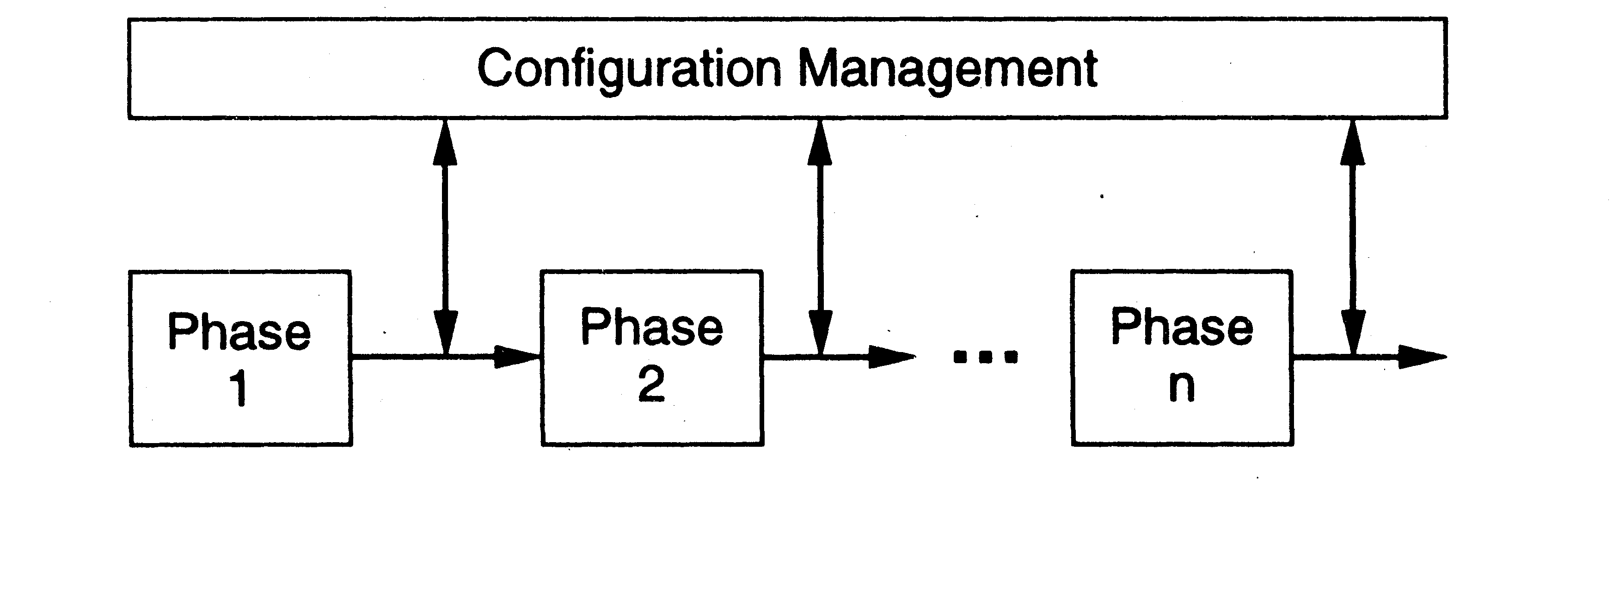
SCM Process and Dev process
Other Processes

Slide 33
Need for CM
To satisfy the basic project objective of delivering the product to the client
  What files should comprise the product
  What versions of these files
  How to combine these to make the product
Just for this, versioning is needed, and state of diff items has to be tracked
There are other functions of CM also
Other Processes

Slide 34
Functionality Needed
Give states of programs
Give latest version of a program
Undo a change and revert back to a specified version
Prevent unauthorized changes
Gather all sources, documents, and other information for the current system
Other Processes

Slide 35
CM Mechanisms
Configuration identification and baselining
Version control
Access control
These are the main mechanisms, there are others like naming conventions, directory structure,…
Other Processes

Slide 36
Configuration Items
Sw consists of many items (some artifact)
In CM some identified items are placed under CM control
Changes to these are then tracked
Periodically, system is built using these items and baselines are established
Baseline – logical state of the system and all its items; is a reference point
Other Processes

Slide 37
Version and access control
Key issues in CM
Done primarily on source code through source code control systems, which also provide access control
Allows older versions to be preserved and hence can undo changes
Eg: CVS and VSS are commonly used; Clear case for large projects
Other Processes

Slide 38
Version and Access Control
When programmer developing code – is in private area
When code is made available to others, it goes in an access-controlled library
For making changes to an item in library, it has to be checked out
Changes made by checking-in the item – versioning is automatically done
Final system is built from the library
Other Processes

Slide 39
Version/Access Control
Generally both version and access control done through CM tools like VSS, SCCS
Tools limit access to specified people - formal check in, check out procedures
Automatic versioning done when a changed file is checked-in
Check-in, check-out control may be restricted to a few people in a project
Other Processes

Slide 40
CM Process
Defines the activities for controlling changes
Main phases
  CM Planning
  Executing the CM process
  CM audits
Other Processes

Slide 41
CM Planning
Identify items to be placed under CM
Define library structure for CM
Define change control procedures
Define access control, baselining, reconciliation, procedures
Define release procedure
Other Processes

Slide 42
CM Audit
During project execution CM procedures have to be followed (e.g. moving items between directories, naming, following change procedures, …)
Process audit has to be done
CM audit can also check if items are where they should be
Other Processes

Slide 43
Summary – CM
CM is about managing the different items in the product, and changes in them
Developing a CM plan at the start is the key to successful to CM
CM procedures have to be followed; audits have to be performed
Requires discipline and tools
Other Processes

Slide 44
Requirements Change Management Process
Other Processes

Slide 45
Background
Requirements change. At any time during the development
Changes impact the work products and the various configuration items
Uncontrolled changes can have a huge adverse impact on project in cost/sched
Changes have to be allowed, but in a controlled manner
Other Processes

Slide 46
A Change Mgmt Process
Log the changes
Perform impact analysis on the work products and items
Estimate impact on effort and schedule
Review impact with stakeholders
Rework the work products/items
Other Processes

Slide 47
Changes
Change often triggered by change request
Change req log keeps a record of requests
Impact analysis for a change request involves identifying the changes needed to diff items, and the nature of change
The impact of changes on the project is reviewed to decide whether to go ahead
Cumulative changes also often tracked
Other Processes

Slide 48
Process Management Process
Other Processes

Slide 49
Background
A process is not a static entity – it has to change to improve the Q&P
Focus of process management is to evaluate and improve the process
Is different from project management which focuses on a project
Process management is an advanced topic
Other Processes

Slide 50
Software Process Improvement
To improve the process, an org must understand the current process
  Requires process be properly documented
  Properly executed on projects
  Data is collected from projects to understand the performance of process on projects
Changes to process are best made in small increments
Other Processes

Slide 51
Software Process Improvement Frameworks
What changes should be made to the process and when
Frameworks suggest ways of how process improvement can proceed
Capability Maturity Model (CMM) is one of the most common frameworks
Other Processes

Slide 52
CMM
CMM has five maturity levels for a software process (level 1 is ad-hoc)
In a level, process has some capabilities and lays the foundation for next level
For moving from one level to another, CMM specifies areas to focus on
Is used heavily by sw industry
Other Processes

Slide 53
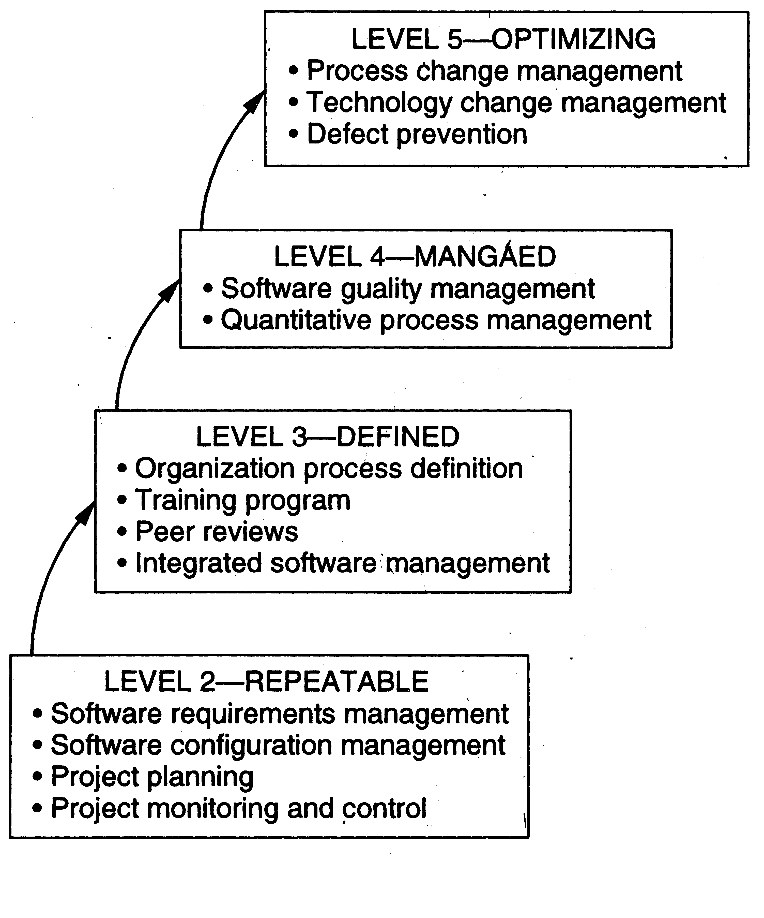
CMM
Other Processes

